Slide 2
Objectives
Students will learn to
count and add two-digit whole numbers.
subtract single-digit numbers.
solve easy equations with symbols.

Slide 3
Tools, materials and organisation
Chalk or stone to draw the game on the ground.
Prepare copies of the student worksheets.
The lesson takes 45 minutes or more.

Slide 4
Description of the lesson
Divide the lesson into three parts
First part: explain the game.
(Useful link https://www.youtube.com/watch?v=F81h01Asr7U)
Second part: play the game and complete the worksheet exercises.
Third part: check students’ answers and provide necessary
explanations.

Slide 5
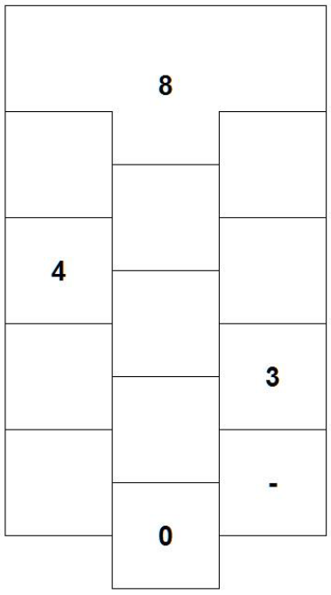
EXERCISE 1
Fill the calculator hopscotch with the missing numbers and symbols.
Methodology
Students compare their worksheet grid to the one drawn on the ground and locate which digits and math symbols are missing, and then fill in accordingly.

Slide 6
EXERCISE 2
Which squares should you jump into to solve the following equation:
5+3= __
Methodology
With the teacher’s help, students use an abacus or their fingers
to understand number 5 and number 3.
On one wire of the abacus they slide 5 beads, and on the wire underneath they slide 3 beads.

Slide 7
Students count how many beads they have slid altogether.
They jump onto number 8 of the court drawn on the ground.

Slide 8
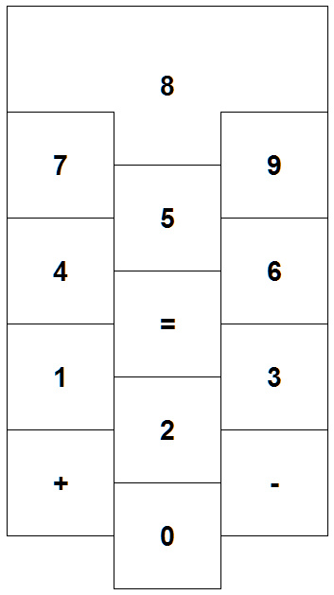
5 + 3 = 8
5
+
3
=
8

